Slide 1
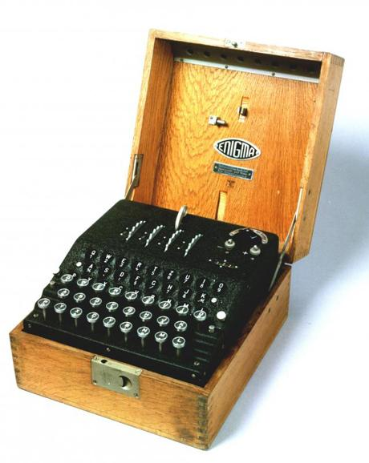
WORLD OF WONDERS :
THE ENIGMA MACHINE
Karen Nguyen

Slide 2
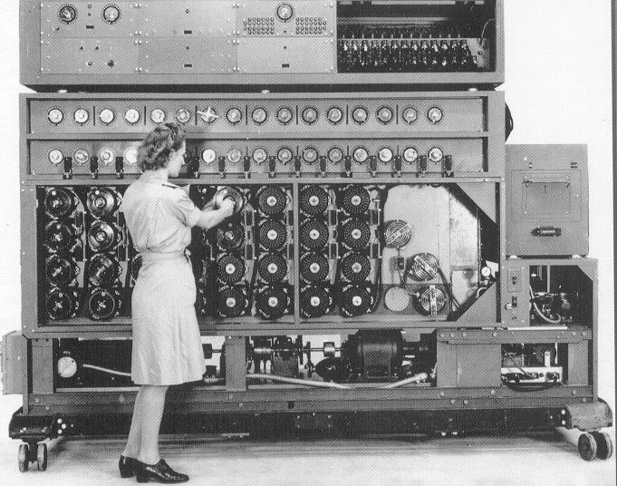
What is the Enigma Machine?
The Enigma Machine was created around the end of World War I by a German engineer named Arthur Scherbius. The Enigma Machine was capable of transcribing coded information, in the hope of sending messages in secure communications. It contained series of electro-mechanical rotor cipher machines, and like any other rotor machines, it contained mechanical and electrical subsystems.
The most commonly known machine was the “bomba” or “bomba kryptologiczna (Polish for "bomb" or "cryptologic bomb") and was a special-purpose machine designed about October 1938 by Polish cryptologist Marian Rejewski to break German Enigma Machine ciphers.
this was used to break the codes
CRYPTOLOGIST: person who works to decipher hidden language, crack secret codes, and find ways to protect info
SUBSYSTEM: a self-contained system within a larger system.

Slide 3
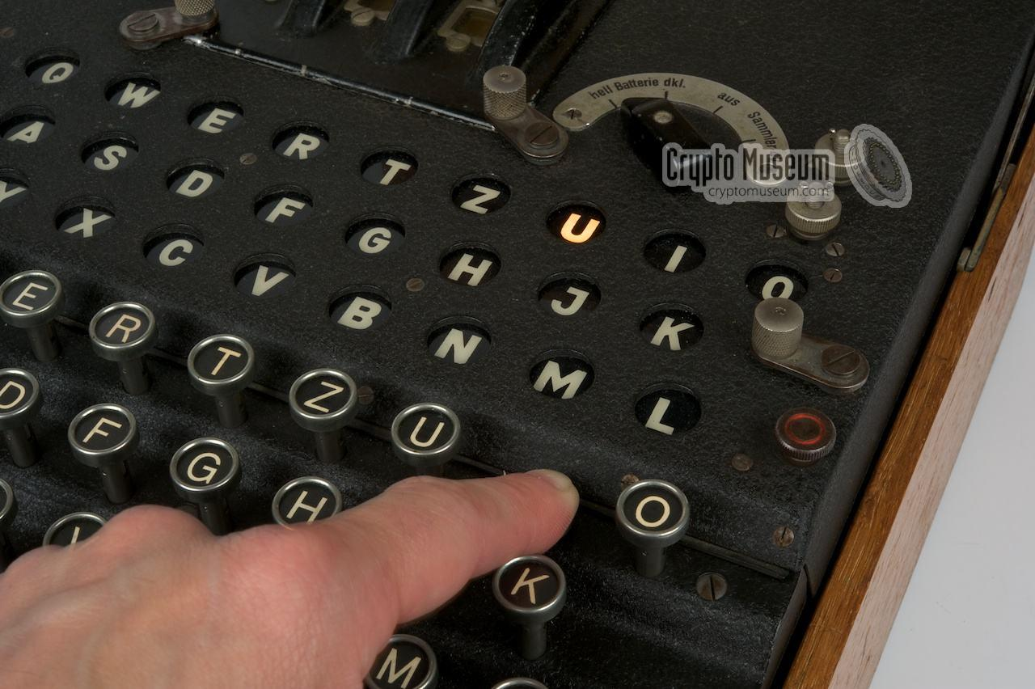
How does it work?
To actually use an Enigma Machine,there’s a keyboard on the bottom and a decoder (lampboard) on top. Let’s say you press letters G & Z. When you press G, the letter H on the lampboard lights up. That means that the letter H is hooked up to the letter G, so the first letter of the message is H (not G). Then if you press the letter Z, the letter I lights up so that means it’s the second letter of the code. So the message you’d be sending would actually be HI instead of GZ. This whole process is called Substitution Cipher.
the person pressed the letter I, but the letter U
lights up on the lightboard. That means the I
actually means the letter U
ENCRYPTION: the process of encoding messages or information in such a way that
only authorized parties can read it

Slide 4
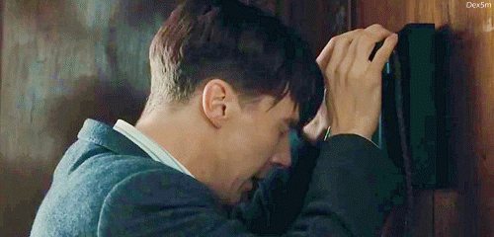
How does it work? PT.2
There are also rotors (small circular disks) with 26 input locations and 26 output locations. Output from the plugboard goes as the input of the first rotor and the output from that goes as the input to the second rotor and so on…
There’s also reflectors and plug-in boards, which are even more parts that make the Enigma Machine even more unbreakable. Plug-in boards help choose which letter would stand for which other letter, and reflectors are just very, very confusing. Reflectors acts on the output of the last rotor and swaps the letters in pairs as new output to the rotors.
Maybe we aren’t meant to understand rotors and reflector. The video will help explain
Me, while i was
learning about how
the enigma works

Slide 5
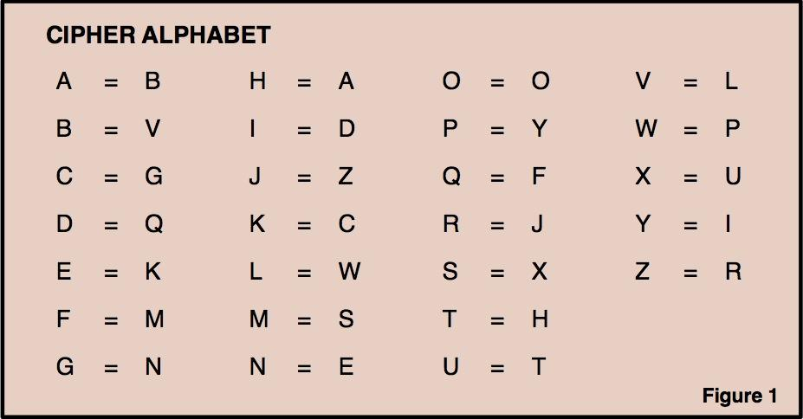
EXAMPLE
Let’s use this cipher alphabet and see if you could crack the code
D QO MKQOJB HJDGCX

Slide 6
The End

